Slide 1
PKG saw-kit cleaning system SW operation manual
ATK-K5EE
Notes:
This is a One Line Title Slide, use for customer facing presentations

Slide 2
Contents
1
Operation
2
Maintenance
3
Recipe
4
Configure
5
Alarm list
Notes:
This is an Agenda slide with numbered options
Click the text box, remove existing content and add your agenda content

Slide 3
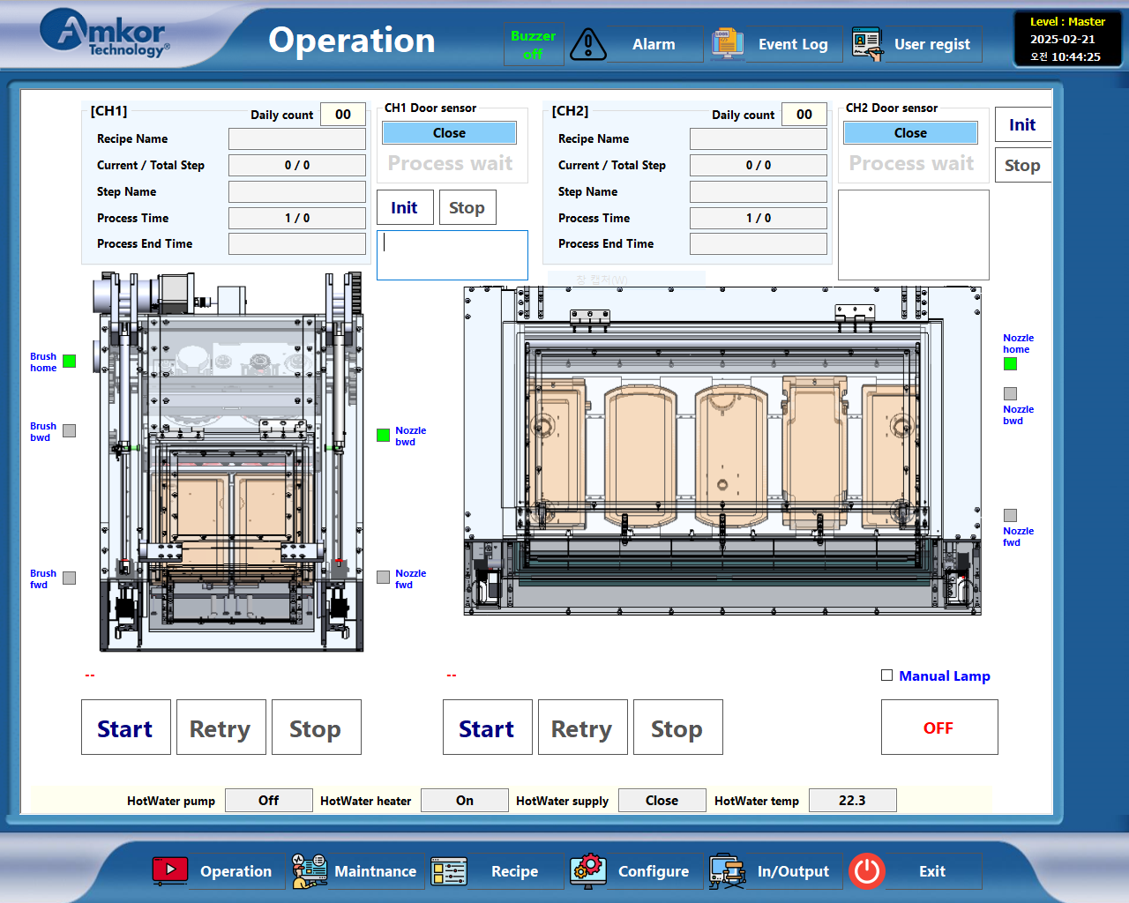
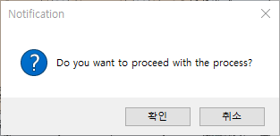
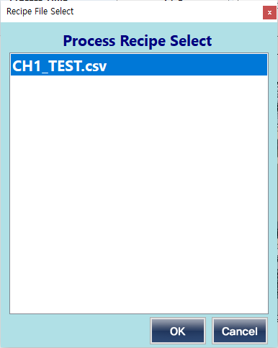
1
Operation
1. Close the front door of the equipment and press the Start button.
When the following window appears, click the OK button.
2. After selecting the recipe file, click the OK button.
2
1

Slide 4
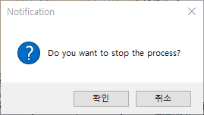
1
Operation
3. When you want to stop the process, press the Stop button.
3

Slide 5
1
Operation
5
4. If an alarm occurs and you take action,
press the Retry button to restart the process.
* CH2 also has the same function.
5. When the buzzer sounds, press the manual Off button.
4

Slide 6
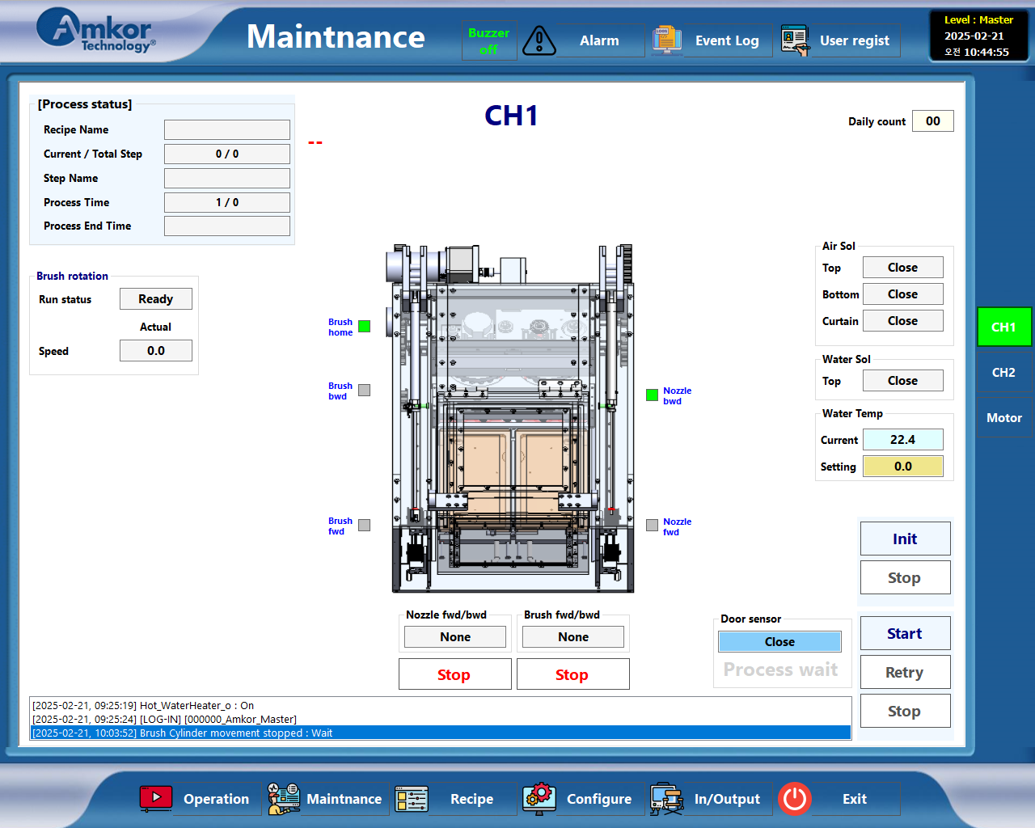
2
Maintenance
1. When you press the Maintenance button,
a screen like the one on the left will appear.
You can proceed on this screen in the same way as on the work
screen.
2. Individual IO operations are possible.
2
1

Slide 7
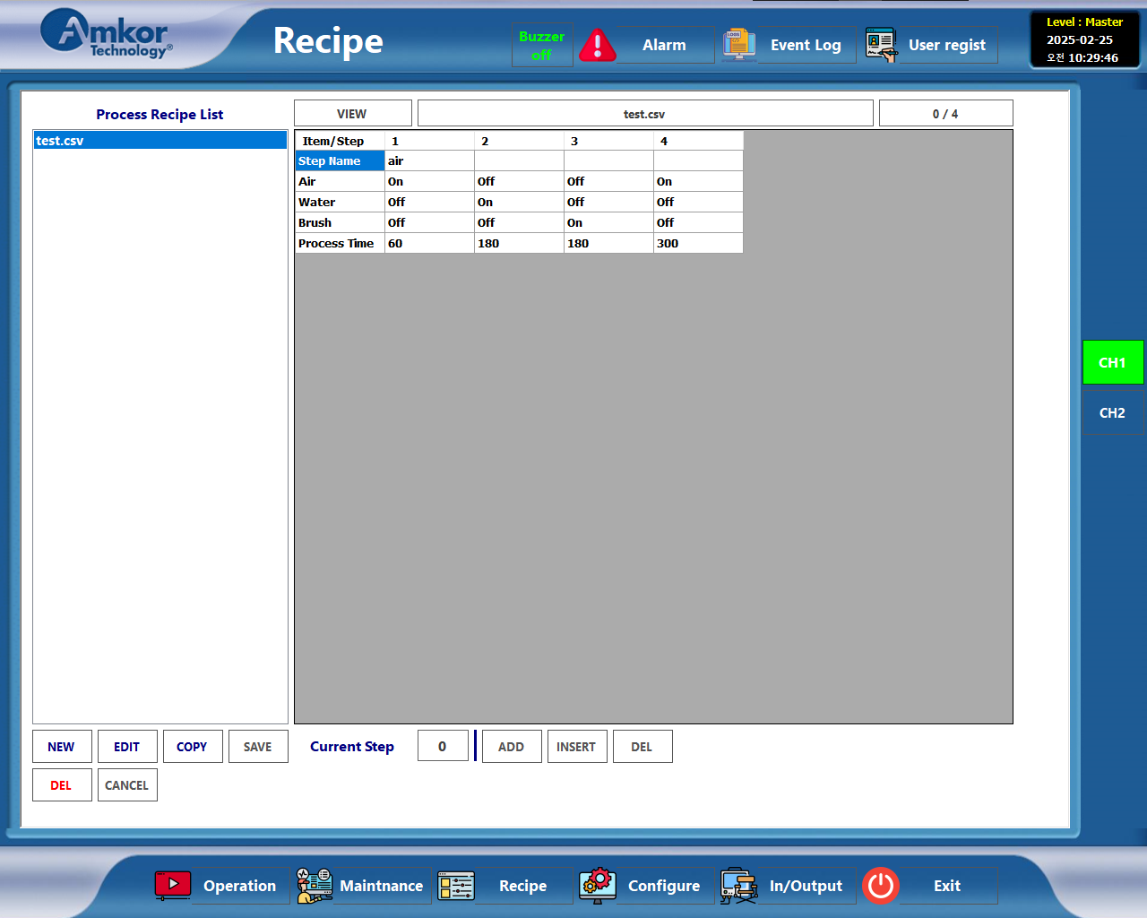
3
Recipe
1. Create / Edit / Copy / Save / Delete / Cancel buttons
- Create : Create a new Recipe file
- Edit : Modify Recipe Contents
- Copy : Copy Recipe File
- Save : Create a recipe and save it as a file (csv file)
- Delete : Delete Recipe File
- Cancel : Create and edit recipes Cancel
2. Add / Insert / Delete
- You can add, insert, or delete each step of the recipe.
One recipe can contain up to 50 steps.
1
2

Slide 8
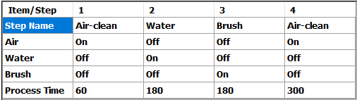
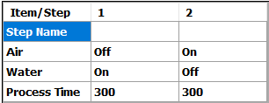
3
Recipe
1. CH1 Recipe
(1) Step name : User writes randomly
(2) Air : Whether to use air for drying function
(3) Water : Whether to use water in the washing function
(4) Brush : Tool cleaning function using brush
(5) Process Time : Each Step progresses for the set time (unit: seconds)
2. CH2 Recipe
(1) Air / Water : Same function as CH1

Slide 9
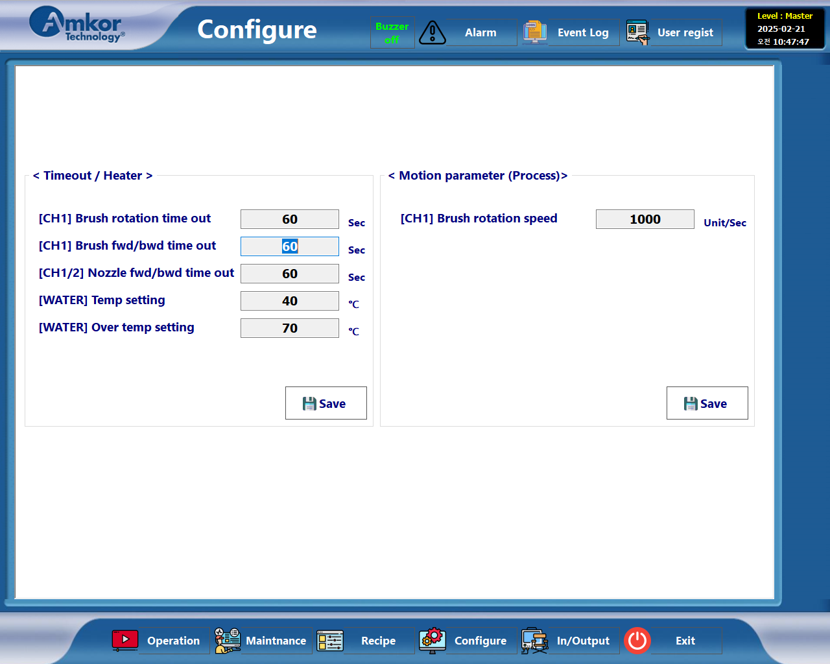
4
Configure
< Timeout >
(1) Brush rotation time out
- An alarm will sound if the brush motor does not rotate for a certain
period of time.
(2) Brush fwd/bwd time out
- If the Brush motor does not reach the Fwd/Bwd position for the set time,
an alarm is generated.
(3) Nozzle fwd/bwd time out
- An alarm occurs if the Nozzle (Water/Air) does not reach the Fwd/Bwd
position for the set time.
(4) [WATER] Temp setting
- Set water temperature
(5) [WATER] Over temp setting
- Set water temperature upper limit
(alarm occurs when set temperature is exceeded)
<Motion parameter (Process)>
(1) Brush rotation speed
- Setting the Brush rotation speed of CH1

Slide 10
5
Alarm list
< Code / Name : 1010 / Failed to read recipe file >
Occurs when a Recipe file cannot be loaded at the start of a process.
< Code / Name : 1020 / Nozzle cylinder forward time out >
Occurs when the Nozzle cylinder forward position is not reached within the set time.
< Code / Name : 1021 / Nozzle cylinder backward time out >
Occurs when the Nozzle cylinder backward position is not reached within the set time.
< Code / Name : 1022 / Nozzle cylinder home time out >
Occurs when the Nozzle cylinder home position is not reached within the set time.
< Code / Name : 1030 / Brush cylinder forward time out >
Occurs when the brush cylinder forward position is not reached within the set time.
< Code / Name : 1031 / Brush cylinder backward time out >
Occurs when the Brush cylinder backward position is not reached within the set time.
< Code / Name : 1032 / Brush cylinder home time out >
Occurs when the Brush cylinder home position is not reached within the set time.
< Code / Name : 1045 / Brush rotation run time out (Motor) >
Occurs when brush rotation does not occur
< Code / Name : 1046 / Brush rotation stop time out (Motor) >
Occurs when the Brush rotation stops and does not stop within the set time.

Slide 11
Thank you.
Notes:
This is a Closing slide
This option enables personalized closings or contact information

